Slide 1

Learning & Decision-Making Study
Thank you for participating in this study. The current study is performed by Tel-Aviv University, aimed at gaining better understanding of learning and decision making processes in humans.
In this study, we will ask you to complete a card game using a controller. The study should take about 30 minutes. You are free to leave at any time but note that credit points are provided only for full participation. All data is collected anonymously.
Thank you for your participation and please feel free to contact us for any question you might have.
Press the ‘A’ button on the XBOX controller to accept the terms mentioned above and continue.
Press A to continue

Slide 2
Card Game
Welcome to our card game. We will now provide the instructions. Please read them carefully. In the end of the instructions you will have a short test, to make sure everything is well understood. You need to answer all the questions correctly in order to proceed with the experiment, so please do your best to carefully read the instructions before starting.
Good luck and thank you for participating!
Press the ‘A’ button on the controller to continue.
Press A to continue

Slide 3
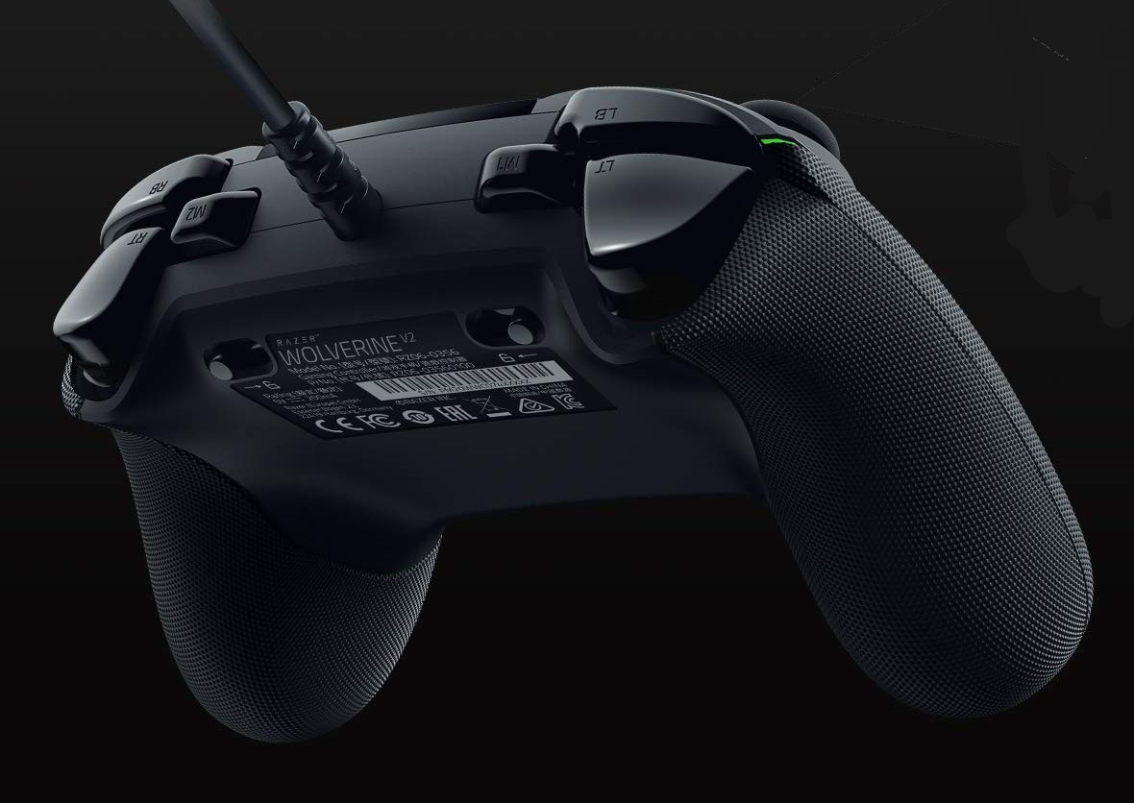
Throughout the game you will be asked to make selections using the right and left bumpers on the controller.
Press Left bumper to select the left object
Press Right bumper to select the right object
Press A to continue

Slide 4




Below is an example deck of four cards, very much like the cards in the game to follow.
Press A to continue

Slide 5
On each step, two cards from the deck will be offered as shown in the example below. You will be able to choose one of the cards using the RIGHT or LEFT bumpers in the controller.
Next
Press A to continue

Slide 6

After selecting a card, you will see an outcome in the middle of the screen, as shown below. The outcome very much depends on the card you choose. Your job is to try and finish the game with as many game-coins as possibles. Two important things to remember:
All cards will sometimes lead to reward. How likely a card to result in a rewarding outcome can change along the game, somewhat similar to the value of market products that sometimes worth more and sometimes less.
Only the cards predict an outcome. The response key that was used to select a card does not influence the chances of winning.
The value of the cards are independent of each other. If you think one card is likely to bring reward, it means nothing regarding all other cards in the deck.
Next
Press A to continue

Slide 7
Try to be focused and choose a card that is likely to earn you a coin or, alternatively, less likely to take a coin from you.
You will now move on to a quick test to make sure that you understood the instructions.
Press A to start the short quiz.
Press A to continue

Slide 8
Test
We would now like to ask you to complete a quick test to make sure all the instructions are well understood.
In order to continue with the experiment you need to answer all the questions correctly.
Choose your answer by pressing the suitable button.
Question 1: What is the size of a card deck?
A. 2
B. 4
X. 6

Slide 9
Moving on to the next question.
Choose your answer by pressing the suitable button.
Question 2: How many cards are presented on each step?
A. 2
B. 4
X. 6

Slide 10
Moving on to the next question.
Choose your answer by pressing the suitable button.
Question 3: How do you choose a card?
A. Click on it
B. Press the LEFT or RIGHT bumper buttons.

Slide 11
Moving on to the next question.
Choose your answer by pressing the suitable button.
Question 4: All cards will sometimes lead to a rewarding outcome. Some are more likely to do so.
A. True
B. False

Slide 12
Moving on to the next question.
Choose your answer by pressing the suitable button.
Question 5: The outcome you might get very much depends on whether you used the RIGHT or LEFT
response key.
A. True, both cards and response keys predict the outcome.
B. False, only cards predict the outcome.

Slide 13
Moving on to the next question.
Choose your answer by pressing the suitable button.
Question 6: If you get a good outcome after choosing a certain card – it means all the other cards in the
deck are:
A. They are worth less.
B. They are worth more.
X. It means nothing regarding other cards. The value of the cards is completely independent.
Knowing something about one card, mean nothing about the others.

Slide 14
You made a mistake.
Press ‘A’ to try again.
Press ‘B’ to go over the instructions again.
Press B for instructions
Press A to continue

Slide 15
Good job! You completed the test.
Before we start the games, we will give you a short practice session.
Next
Press A to continue

Slide 16

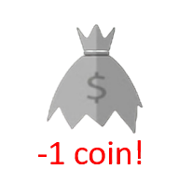
Practice session
We will now practice 5 trials. Every card in the deck can lead you to a gain a game-coin or can lead you to the loss of a game-coin. Below are the four cards that can appear in this round. Use the ‘right’ or ‘left’ bumper buttons on the controller to make your selection.
Press A to continue

Slide 17
Good job. Practice completed! We will now move on to the real game. Do your best to win as much and lose as little coins as possible!
Press A to start the card game
Press A to continue

Slide 18
Test Block 1 out of 3
We will now start a test block with 50 trials. Every card in the deck can lead you to a gain a game-coin or can lead you to the loss of a game-coin. Below are the four cards that appear in this round. Use the ‘right’ or ‘left’ bumper buttons on the controller to make your selection. Do your best to win as much coins as possible!
Press A to continue

Slide 19
Good job!
Test block 1 out of 3 is over. You can stretch a little and take a small break in front of the screen if needed.
Press A to continue
Press A to continue

Slide 20
Test Block 2 out of 3
We will now start a test block with 50 trials. Every card in the deck can lead you to a gain a game-coin or can lead you to the loss of a game-coin. Below are the four cards that appear in this round. Use the ‘right’ or ‘left’ bumper buttons on the controller to make your selection. Do your best to win as much coins as possible!
Press A to continue

Slide 21
Good job!
Test block 2 out of 3 is over. You can stretch a little and take a small break in front of the screen if needed.
Press A to continue

Slide 22
Test Block 3 out of 3
We will now start a test block with 50 trials. Every card in the deck can lead you to a gain a game-coin or can lead you to the loss of a game-coin. Below are the four cards that appear in this round. Use the ‘right’ or ‘left’ bumper buttons on the controller to make your selection. Do your best to win as much coins as possible!
Press A to continue

Slide 23
Well done. You’ve finished the game.
Thank you for your participation!

Slide 25


